Slide 1
Peter Bromberg, Associate Director
EveryLibrary | EveryLibrary.org | FightForTheFirst.org
Real World Policy and Messaging Issues
From the Trenches

Slide 4
Real World Policy and Messaging Issues From the Trenches
Practical advice on shoring up your policy and messaging to defend against book-banning
Library 2.0 Virtual Conference June 8, 2023
Banned Books and Censorship: Current Intellectual Freedom Issues in the LIbrary
Peter Bromberg | EveryLibrary | EveryLibrary.org

Slide 5
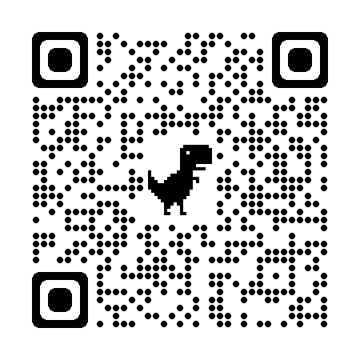
RESOURCES 1
bit.ly/realworldmessaging

Slide 6
OBJECTIVES
Attendees will learn practical ways to navigate in our increasingly polarized political environment, using policy and effective messaging to inoculate and defend against the well-organized national wave of book-banning
Notes:
So let’s look at your Selection Policy

Slide 7
about everylibrary

Slide 8
EveryLibrary | Pro Bono 501(c)4 Political Action Committee for Libraries
Election Days and Negotiations
Support for Legislative School Librarian Agendas
Crisis/Censorship/Rapid Response
Outreach and Activism to the Public
100% Donor Supported
EveryLibrary Institute - 501(c)3 Research and Policy Think Tank
Research Agenda
Training Programs
Programmatic Partnerships and Coalitions

Slide 9
Who We Work With on Censorship and Attacks on Librarians
We work with everyone, on political problems and solutions
at every point in the system across 50 states
Librarians (public and school)
Parents / Citizen Advocacy Groups
State Libraries and Associations
Directors
Boards (Library, LEA,Foundation, Friends)
Legislators
Coalition Partners

Slide 10
ENVIRONMENTAL SCAN

Slide 11
Environmental Scan: Challenges are on the rise
We are seeing Increases in public libraries challenges from groups that were organized to protest masks, and then turned to school libraries and curricula.
The nationwide network of individuals and groups is getting stronger and better networked.
Challenges are focused on diverse content (Authors/topics related to Black, Indigenous, or Persons of Color; Black American History aka “CRT books”)

Slide 12
Environmental Scan: Challenges are on the rise
It’s not just book challenges, it’s also legislation and actions to take over or disempower Library Boards
Anti-access legislation is being drafted/passed
Legislation allowing for civil and criminal penalties against librarians, teachers, board members
Legislative bans or limits on discussing or teaching certain topics (“anti-indoctrination” bills)
Boards are politicized Laws are being re-written to allow politicization of board appointments

Slide 13
THE IMPORTANCE OF GOOD POLICY

Slide 14
The Role and Value of Good Policy
Policy flows from & reflects the purpose/mission of the Library
Policy governs day-to-day operations
Policy ensures compliance with laws and regulations and protects the rights of all patrons and staff
Policy reflects commitment to ALL residents
Policy provides transparency in standards and procedures
Policy ensures due process and consistency of service
Policy-making is one of the most important Board duties
Policies require full understanding/support of all Board members

Slide 15
Elements of a Good Collection Development Policy
Literary quality; Attention of critics, reviewers, awards, popularity
Expertise, reputation, qualifications and significance of Author/Producer/Publisher
Content reflects a wide variety of perspectives and authors
Accuracy, currency, timeliness, and validity
Local, self-published, independent, and small producers
Format: Physical quality of; effectiveness of; appropriateness of; Resources in formats that meet the needs of users with disabilities
Cost; Availability of discounts; efficiency of vendors
Availability of subscriptions / standing orders for popular materials, reference and nonfiction items published or released annually

Slide 16
Elements of a Good Collection Development Policy
Aims for a balanced, diverse, and inclusive collection;
Seeks a variety of ideas, information, stories, and experiences
Considers the need for all subjects covered and viewpoints expressed
Anticipates needs; Considers public demand
Considers the availability of the same, or similar, materials in other libraries or agencies
Notes:
These elements are all related to intellectual freedom

Slide 17
Elements of Good Policy: Summary
Is it good? (i.e. well-reviewed content; trusted authors/publishers)
Is it good? (i.e. physically well-constructed)
Is it good? (i.e. accurate, timely, valid)
Is it affordable? (cost? discounts?)
Is it reflective of a variety of perspectives
Is it in accessible or preferred formats?

Slide 18
Elements of a Good Reconsideration of Materials policy
References the selection policy. Reinforces that selection is based on the merits of the material and its value to the collection.
Stresses that the use of materials by patrons is an individual matter
Notes that the responsibility for children/teen use of materials rests with their parents or guardians. (Library does not act “in loco parentis”)
Places Limits on Who Can Initiate Process: Only residents in the library’s funding jurisdiction may initiate the process.
Require that patron has read/listened to/watched the whole work. “Under penalty of perjury, I swear or affirm that…”
There is a transparent procedure that guides a deliberative process.

Slide 19
Elements of a Good Reconsideration of Materials policy
Notes that decisions regarding content in the library collection may implicate certain protections under the First Amendment.
The Director or designee shall apply the selection criteria and consider each work as a whole. Excerpts will not be assessed out of context.
The policy should specify who will notify the patron and by when. Recommend that this come from the Director or Head of Acquisitions.

Slide 20
Appropriate Application of Reconsideration of Materials policy
Appeal should not re-litigate the decision
Appeal should focus narrowly on whether the policies and procedures were followed by staff and Director (i.e. were selection criteria in policy appropriately applied?)
If they were followed, the decision should be upheld.
If they were not followed, Board should “remand” to Director to reconsider the request.
Appeals are a possible danger zone for the board

Slide 21
Appropriate Application of Reconsideration of Materials policy
Appeal should not re-litigate the decision
Appeal should focus narrowly on whether the policies and procedures were followed by staff and Director (i.e. were selection criteria in policy appropriately applied?)
If they were followed, the decision should be upheld.
If they were not followed, Board should “remand” to Director to reconsider the request.
Appeals are a possible danger zone for the board
DANGER ZONE

Slide 22
Effective Messaging
Requires us to speak their language

Slide 23
Framing our Message Three Languages of Politics
We have to tailor our message to the audience in front of us.
Not every person cares about the same issues, or sees the world in the same way.
Notes:
LECTURE - READ SLIDE
We have to tailor our message to the audience in front of us.
Not every potential supporter cares about the same issues, or sees the world in the same way.

Slide 24
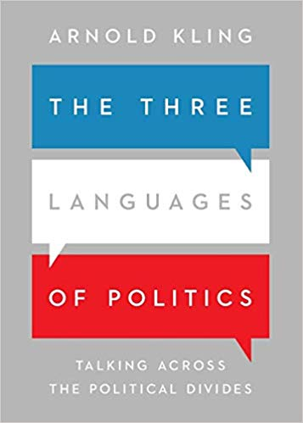
The Three Languages of Politics by Arnold Kling
Progressive Support the vulnerable, oppressed, marginalized Speak to Equity , Social Justice
Libertarian Support individual rights, liberty, and small government Speak to Liberty, Gumption, and Self-Direction
Conservative Support western values, traditions, morals, law and order Speak to Shared Culture & Traditional American Values

Slide 25
Example: Framing Book Challenges
Progressive Speak to Equity and Social Justice “Having books representing traditionally underserved or marginalized communities helps kids see themselves represented in a positive way and helps others build understanding and empathy”

Slide 26
Example: Framing Book Challenges
Libertarian Speak to Self-Direction and Liberty “The Library, as an arm of the government, shouldn’t be determining what people should be reading. We believe citizens have the liberty to make those decisions for themselves. And we trust parents to parent their children. We don’t want to usurp their role.”

Slide 27
Example: Framing Book Challenges
Libertarian Speak to Self-Direction and Liberty “Offering a wide range of texts, formats, and ideas helps students critically evaluate and process information. Choosing what to read, within the framework of their family’s values and beliefs, prepares our kids for success and fosters their ability to safely and independently navigate information spaces like the Internet and social media.

Slide 28
Example: Framing Book Challenges
Conservative Speak to American Values / Strength / Law and Order
“Our policies that protect access to legally published materials are guided by a century of law, and are based on First Amendment of the Constitution of the United States - which also protects our Freedom of Religion. America’s Founding Fathers believed that these bedrock rights needed to be protected for Americans to thrive and prosper. We don’t want to chip away at 1A”

Slide 29
Example: Framing Book Challenges
Conservative Speak to American Values / Strength / Law and Order
“Parents tell us that they want to raise strong kids who will be able to compete and succeed in an increasingly diverse and global economy. It’s important to them that their kids learn as much as they can about the world; the good, the bad, and the ugly, so they’ll be well-prepared for career success and to be leaders in our community.”

Slide 30
Three Languages of Politics DANGER WILL ROBINSON!
We have created very progressive language around libraries…

Slide 31
Three Languages of Politics DANGER WILL ROBINSON!
We tend to default to talking about the library in ways
that reflect OUR OWN POLITICAL WORLDVIEW

Slide 32
Three Languages of Politics DANGER WILL ROBINSON!
We must therefore know our default worldview and intentionally use language that will appeal to others

Slide 33
Three Languages of Politics DANGER WILL ROBINSON!
Talking like an ALA/OIF strongly worded letter or press release may not be recipe for success in your neck of the woods.

Slide 34
Effective Keywords and Concepts: Left of Center
Access Equity Environment Choice Standards Social Justice | Systemic Problems Class / Class Structure Microaggressions Privilege Inclusion Diversity
Adapted from Utah Cultural Alliance

Slide 35
Effective Keywords and Concepts: Right of Center
Fiscal Responsibility Families Morality Freedom / Liberty ROI Opportunity | Guidelines Self-reliance Honoring vets & military Boost jobs/economy Serving rural America Local control
Adapted from Utah Cultural Alliance

Slide 36
perceptions of book banning in the united states
some good news and insights into messaging!

Slide 37
Voter perceptions of book banning in the united states: Key Points and Messaging 1
The EveryLibrary Institute commissioned a public opinion poll of American voters to understand political support and opposition to book banning.
The poll, conducted by Embold Research, a nonpartisan research firm, surveyed 1,123 registered voters from August 31st-September 3rd with a margin of error of 3.4%. The survey looked at the differences in beliefs among voters segmented by age, gender, race/ethnicity, education, and 2020 presidential vote.
Download the report at: everylibraryinstitute.org/bookbanpoll

Slide 38
Voter perceptions of book banning in the united states: Key Points and Messaging 11
Only 8% of voters think “there are many books that are inappropriate and should be banned.”
Only 16% think believe public school libraries include inappropriate books on their shelves.
The latest American Family Survey indicates that just 12% of Americans agree that books should be removed from libraries if a parent objects.

Slide 39
Voter perceptions of book banning in the united states: Key Points and Messaging 2
Common-sense messaging is most broadly effective. It is more effective than saying that proponents of book banning are simply afraid of anyone who is different from them, or bigoted, hateful, etc.

Slide 40
Voter perceptions of book banning in the united states: Key Points and Messaging 3
Libraries and librarians are broadly favorably viewed so libraries are entering this issue from a position of strength - American voters have a high regard for libraries, and certainly have more affinity for libraries and librarians than they do for politicians.

Slide 41
Voter perceptions of book banning in the united states: Key Points and Messaging 8
Investigative reports show that small number of extremists are filing the bulk of challenges
Parents overwhelmingly oppose book bans, and don’t think there are problematic books on shelves, or that books should be pulled if parents object.
They trust librarians, not politicians on this issue

Slide 42
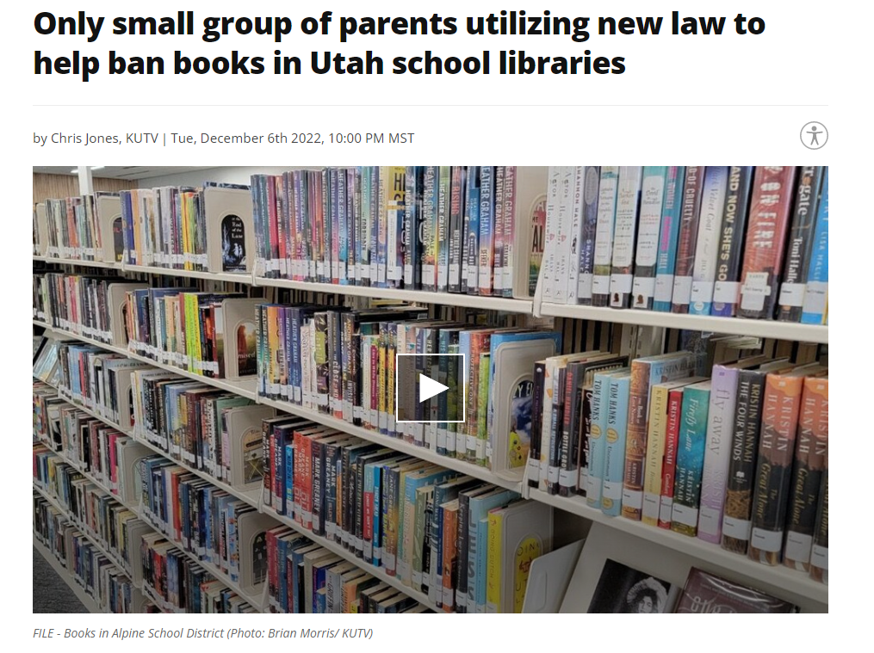
Voter perceptions of book banning in the united states: Key Points and Messaging 8
Of the 205 challenges, one married couple were behind 199 of them.
Outside of Granite, only 35 parents have filed complaints against books, most of them in Davis County where UPU is headquartered.

Slide 43
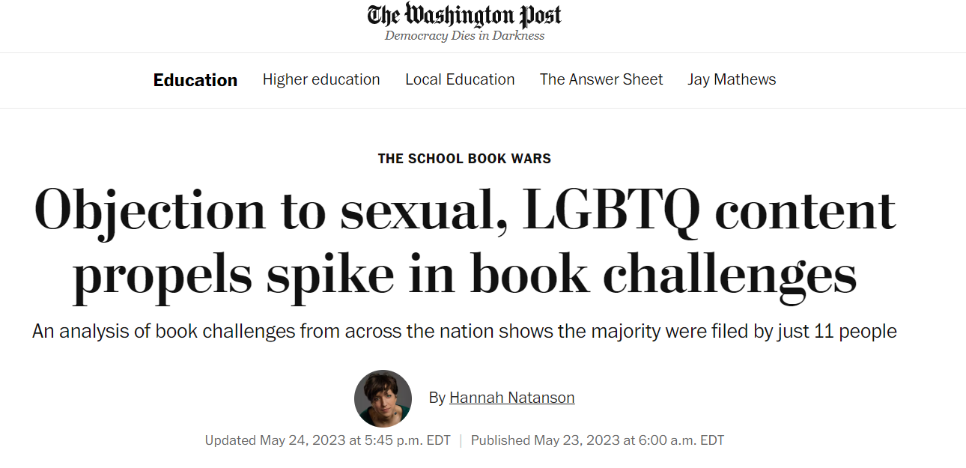
Voter perceptions of book banning in the united states: Key Points and Messaging 8

Slide 44
Voter perceptions of book banning in the united states: Key Points and Messaging 4
It is effective to make specific books emblematic of this issue as a whole. Of those tested, it’s most effective to highlight children’s books and classic novels.
Point out exactly which books will be pulled if proposed (or existing) policy or law is applied.

Slide 45
Voter perceptions of book banning in the united states: Key Points and Messaging 9

Slide 46
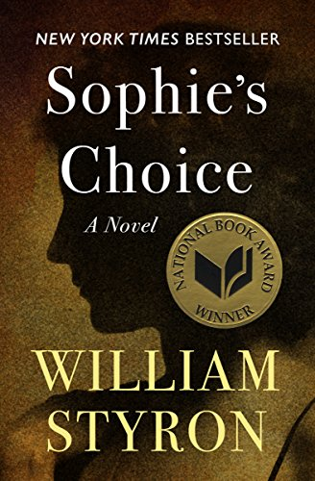
Voter perceptions of book banning in the united states: Key Points and Messaging 9

Slide 47
Voter perceptions of book banning in the united states: Key Points and Messaging 9

Slide 48
Voter perceptions of book banning in the united states: Key Points and Messaging 5
Voters are most offended by the idea that children and classic books are being banned
Banning classic novels and children’s books are nearly universally opposed
Support for banning increases to 18% when discussing books that focus on race
There is the greatest support (34%) for banning books about sexuality

Slide 49
Voter perceptions of book banning in the united states: Key Points and Messaging 6
Voters are receptive to describing politicians who support book banning as short-sighted
Voters are less likely to respond to accusations that book banners are “racist” or “homophobic”. So messaging to them on racism/homophobia will not be effective

Slide 50
Voter perceptions of book banning in the united states: Key Points and Messaging 7
The possibility of charging library employees emerges as worrying among Republicans and Independents. We should talk about how this is happening around the country. (UT, TX, RI, WY, FL, MI, WA, MO, etc.)

Slide 51
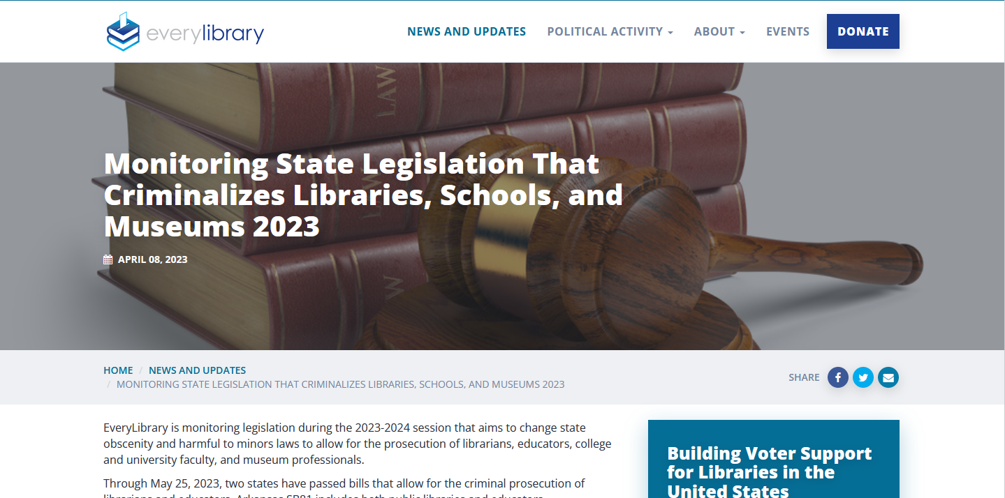
everylibrary.org/state_obscenity_laws_23-24

Slide 52
RESOURCES 1
bit.ly/realworldmessaging

Slide 53
Thank you!!
(see bonus slides that follow)

Slide 54
Bonus Slides 1

Slide 55
Effective Messaging
Affirm, don’t oppose
Employ the “Yes, and…” technique

Slide 56
Responding to Challenges
Employ “Yes, And…”
Start by positively affirming the underlying value or concern that is being expressed. In book challenges, the underlying values/concerns tend to be: parental control; age-appropriate reading materials; child safety.

Slide 57
Responding to Challenges
Employ “Yes, And…”
EXAMPLE: These materials are not age-appropriate for my children and I don’t think they should be reading this smut.
I hear that ensuring your age-appropriate materials is very important to you. Children develop at different rates, and parents have different standards for their children. To support the needs of all patrons, we group materials by age of intended audience, and provide many tools and one-on-one consults to help kids and empower parents to make informed reading choices that work for them.

Slide 58
Responding to Challenges
Employ “Yes, And…”
EXAMPLE: Well, I don’t think anyone’s kids should read these books because their pornographic.
Thank you for sharing your concerns. I understand that what materials are available in the library is very important to you. I can provide you with a copy of our selection policy, and if you are still concerned that these materials fall outside of the scope of the policy we welcome you to initiate a request for reconsideration.

Slide 59
Responding to Challenges
Employ “Yes, And…”
EXAMPLE: Well, I don’t think anyone’s kids should read these books because their pornographic.
I understand that you think these books are not appropriate for your children and can help you make acceptable selections for your child. And we extend that same respect for parental oversight to all parents, who can determine the guidance and level of freedom they want to give their children when choosing what to read.”

Slide 60
Responding to Challenges
Employ “Yes, And…”
EXAMPLE: These books are obscene and pornographic.
I’m hearing that you don’t like the content of these books. I want to assure you that we don’t purchase materials from any publishers that publish materials that meet our state’s definitions of obscenity or pornography. I’m happy to help you find books that are more aligned with your interests and values.

Slide 61
Effective Messaging
Techniques for Advocacy

Slide 62
Developing Effective Messaging
27 - 9 - 3
Notes:
KEY POINT -- Messaging is to build support (not to build use )
27-9-3 -- Is a Tried and True Method
Define Audience - and then craft message -
Show examples (slides 21-22)

Slide 63
Developing Effective Messaging
EXAMPLE
Students are struggling with school
The library is helping our kids from slipping
through the cracks
My staff and I are deeply committed to supporting kids, parents, and families.
Notes:
Students are struggling with school
The library is helping our kids from slipping through the cracks
My staff and I are deeply committed to supporting kids, parents, and families.

Slide 64
Developing Effective Messaging
EXAMPLE
Our Main Street has struggled for years.
When libraries are renovated and expanded downtowns are revitalized.
Our library draws thousands of people a month to our downtown shopping area.
Notes:
EXAMPLE
Our Main Street has struggled for years.
When libraries are renovated and expanded downtowns are revitalized.
Our library draws thousands of people a month to our downtown shopping area.
BRIEF EXERCISE: “”Try it now”: Generic Message about your library
Page 4
Timing: 3 minutes to write. 2 minute share out)

Slide 65
Advice From Elected Officials From Awareness to Funding: A study of library support in America (OCLC 2008)
Stress the broad appeal of the library
Be proactive
Build strategic partnerships
Stress the library’s ROI to the community
Notes:
LECTURE - Advice from Electeds (from OCLC Awareness to Funding)
Stress the broad appeal of the library
Be proactive
Build strategic partnerships
Stress the library’s ROI to the community

Slide 66
Advice From Elected Officials From Awareness to Funding: A study of library support in America (OCLC 2008)
Stress the broad appeal of the library
The public library represents a safe, neutral topic on which an elected official could campaign or speak with broad appeal to nonpartisan audiences.
Notes:
LECTURE - Advice from Electeds (from OCLC Awareness to Funding)
Stress the broad appeal of the library:
The public library represents a safe, neutral topic on which an elected official could campaign or speak with broad appeal to nonpartisan audiences.

Slide 67
Advice From Elected Officials From Awareness to Funding: A study of library support in America (OCLC 2008)
Stress the library’s ROI to the community (how we “stand in the gap”)
Elected officials noted that the library’s ROI is unique to a community and can change over time. This ranges from keeping children off the street, to education of residents leading to wealth creation for the community. Officials also speak frequently of the universal and important role libraries play in providing access to technology for the broader community.
Notes:
Stress the library’s ROI to the community
(we can “stand in the gap”)
Elected officials noted that the library’s ROI is unique to a community and can change over time. This ranges from keeping children off the street, to education of residents leading to wealth creation for the community. Officials also speak frequently of the universal and important role libraries play in providing access to technology for the broader community.
THOUGHTS FEEDBACK ON ADVICE FROM ELECTEDS? (ASK YOUR OWN ELECTEDS…)
NEXT UP: DATA AND STORIES

Slide 68
Effective Messaging
Combining Data and Stories

Slide 69
Combining Stories/Data for Maximum Impact
People make decisions emotionally
Data alone will not persuade
Support for the library is driven by emotion and belief in the library’s positive impact in the lives of community members.
Notes:
3:20 - 3:45
LECTURE
People make decisions emotionally: Data alone will not persuade
Support for the library is driven by emotion and belief in the library’s positive impact in the lives of community members.

Slide 70
Combining Stories/Data for Maximum Impact
DATA
We referred 37 people to VOA for housing assistance in the last quarter.
Notes:
EXAMPLE: DATA
We referred 37 people to VOA for housing assistance in the last quarter.

Slide 71
Combining Stories/Data for Maximum Impact
STORY
I'm writing in regard to one of your librarians to tell you a bit about how she helped my wife and I at a time when we were in dire need and feeling extremely distraught. I'm pretty sure that if we hadn't met this sensitive librarian compassionately acting beyond her duties to put us in touch with those who she hoped could help us that we'd probably be dead, considering the depth of our despair.
Notes:
EXAMPLE: Story
I'm writing in regard to one of your librarians to tell you a bit about how she helped my wife and I at a time when we were in dire need and feeling extremely distraught.
I'm pretty sure that if we hadn't met this sensitive librarian compassionately acting beyond her duties to put us in touch with those who she hoped could help us that we'd probably be dead, considering the depth of our despair.

Slide 72
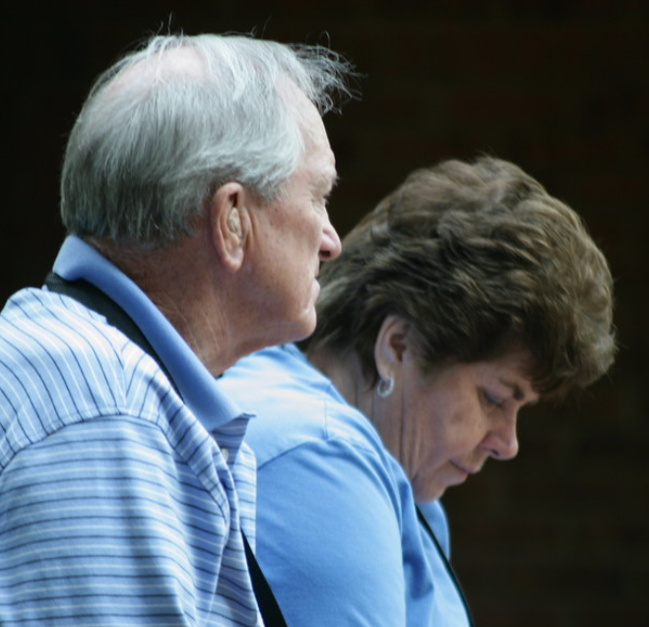
Combining Stories/Data for Maximum Impact
Story/Quote/photo → Data/Multiplier → Outcome
“If we hadn’t met this sensitive librarian we’d probably be dead. She helped at a time when we were in dire need and extremely distraught ”
148 Housing Referrals in 2021
Supportive Housing helps people live and thrive in the community; less likely to be incarcerated; aids people with disabilities in getting better healthcare; and help seniors stay in the community as they age. Source: Center on Budget and Policy Priorities
Harry and Gladys Smith
(Formerly homeless Library patrons)
Photo by tango.mceffrie is licensed under CC BY-NC 2.0
Notes:
Combining Stories/Data for Maximum Impact
“If we hadn’t met this sensitive librarian we’d probably be dead. She helped at at a time when we were in dire need and extremely distraught ”
148 Housing Referrals in 2021
Supportive Housing helps people live and thrive in the community; less likely to be incarcerated; aids people with disabilities in getting better healthcare; and help seniors stay in the community as they age.
Source: Center on Budget and Policy Priorities

Slide 73
Combining Stories/Data for Maximum Impact
Story/Quote/photo → Data/Multiplier → Outcome
“My grandma takes me to the Library every week – I’ve read 127 books since I got my new card last year!”
Reading builds vocabulary which is a key indicator of future academic success (Marzano & Pickering, 2005)
Notes:
Combining Stories/Data for Maximum Impact
“My grandma takes me to the Library every week – I’ve read 127 books since I got my new card last year!”
26,000 new cardholders after fine free
Reading builds vocabulary which is a key indicator of future academic success
Source: (Marzano & Pickering, 2005)

Slide 74
MAPPING YOUR COMMUNITY
Messaging the Library 102
Educational Stakeholders: “Who else cares about education?”
Social Welfare or Faith-Based Stakeholders: “Who else cares about the same populations?”
Governmental Stakeholders: “Who Cares What Your Tax Rate is?”
Civic/Social/Arts Organization Stakeholders: “Who Else Wants to Change the World a Bit?”
Business Stakeholders: “Who Doesn’t Always Know about how libraries support a healthy, thriving economy?”
Politicians and Local Elected officials: “Who else has constituents and cares about the overall healthy functioning of the community?”
Formal/Informal Media and Social Networks: “Who needs to hear it first?”
Notes:
There is value in practicing 27/9/3 and having a story/data/outcome for each sphere in the community
Build relationships and basis for coalition across the community
Intentional Relationships / targeted messaging
I’m providing this as a resource
Activity with staff?
Encourage you to map this out - with names -- and then start reaching out.
Remember: think of these as listening tours
Educational Stakeholders: “Who else cares about education?”
Social Welfare or Faith-Based Stakeholders: “Who else cares about the same populations?”
Governmental Stakeholders: “Who Cares What Your Tax Rate is?”
Civic/Social/Arts Organization Stakeholders: “Who Else Wants to Change the World a Bit?”
Business Stakeholders: “Who Doesn’t Always Know about how libraries support a healthy, thriving economy?”
Politicians and Local Elected officials: “Who else has constituents and cares about the overall healthy functioning of the community?”
Formal/Informal Media and Social Networks: “Who needs to hear it first?”

Slide 75
Politics and Advocacy
What is Advocacy?.
We do X (activity) to Bring about Y (belief, attitude, feeling, action)
Notes:
What is Advocacy?
We do X (activity)
to Bring about Y (belief, attitude, feeling, action)

Slide 76
What is Advocacy?
In other words, advocacy is all about INFLUENCING OTHERS

Slide 77
Politics and Advocacy
One of your roles as a library board member is to influence others so that sufficient resources are allocated to the Library to ensure the provision of high quality, sustainable Library services.
Notes:
Ask for feedback
What thoughts or feelings does this give rise to?

Slide 78
Politics and Advocacy
Developing Relationships is key .
IMPORTANT BECAUSE WE HAVE NO POLITICAL POWER OR MONEY
INCREASINGLY IMPORTANT IN OUR POLARIZED POLITICAL ENVIRONMENT
Notes:
If your role as Director is to exert influence… then…
Developing Relationships is key
IMPORTANT BECAUSE WE HAVE NO POLITICAL POWER* OR MONEY
INCREASINGLY IMPORTANT IN OUR POLARIZED POLITICAL ENVIRONMENT
Punch point: Relationships are increasingly important

Slide 79
Why People Support Libraries

Slide 80
Why People Support Libraries
Recognize the library’s importance to the community and to a child’s education.
See the library as a vital community resource like public schools, fire and police.
Hold the belief that the library is a transformational force
Not always heavy users of the library, but believe the library is a noble place, important and relevant to the community.
Source: From Awareness to Funding: A Study of Library Support in America (OCLC 2008)
Notes:
Straight Lecture - read the slide
Recognize the library’s importance to the community and to a child’s education.
See the library as a vital community resource like public schools, fire and police.
Hold the belief that the library is a transformational force
Not always heavy users of the library, but believe the library is a noble place, important and relevant to the community.

Slide 81
Why People Support Libraries
Note: Support for the Library is not about usage or features (i.e. collections, programs, circ stats)
It is about a belief in the institution, and the perceived benefit to the community as a whole.
Recognize the library’s importance to the community and to a child’s education.
See the library as a vital community resource like public schools, fire and police.
Hold the belief that the library is a transformational force
Not always heavy users of the library, but believe the library is a noble place, important and relevant to the community.
Source: From Awareness to Funding: A Study of Library Support in America (OCLC 2008)
Notes:
Note: Support for the Library is not about usage or features (i.e. collections, programs, circ stats)
It is about a belief in the institution, and the perceived benefit to the community as a whole.

Slide 82
Why People Support Libraries
“Public perceptions of the librarian are highly related to support. ‘Passionate librarians’ who are involved in the community make a difference.”
Therefore... Speaking authentically and passionately to other leaders and community members about the library’s role in the community will help build support.
* Source:
Notes:
“Public perceptions of the librarian are highly related to support. ‘Passionate librarians’ who are involved in the community make a difference.”
Who is a “librarian”? Care if it’s MLS?
Therefore, as Library Director...
Speaking authentically and passionately to other leaders and community members about the library’s role in the community will help build support.

Slide 83
RESOURCES 1
bit.ly/realworldmessaging

Slide 84
Real World Policy and Messaging Issues From the Trenches
Practical advice on shoring up your policy and messaging to defend against book-banning
Library 2.0 Virtual Conference June 8, 2023
Banned Books and Censorship: Current Intellectual Freedom Issues in the LIbrary
Peter Bromberg | EveryLibrary | EveryLibrary.org

