Slide 1
Seed Library
Melissa Armstrong
February 7th, 2023

Slide 2
Melissa Armstrong
Assistant Director
2011
Go to person- scheduling, periodicals, home delivery, payroll, seeds, garden, outreach, problem solving, book mobile, and intellectual freedom fighter.

Slide 3
What is a Seed Library?
A place where people in your community go to check out and swap open pollinated and heirloom seeds.
Usually provide information on how to properly save seeds, grow your own food, and become more self sufficient.
Our Seed Library only carries heirloom and open pollinated seeds. Which means if saved properly they will grow to be just like their parent plant.

Slide 4
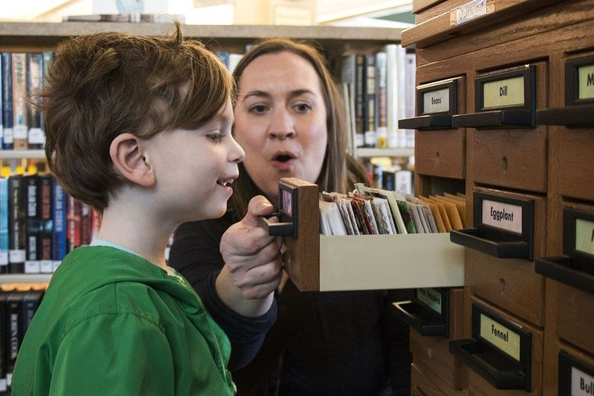
Why Seed Libraries?

Slide 5
Objectives
Learn why seed libraries are so important
Find out how easy it is to start a seed library
Learn how to grow your seed program to engage your community

Slide 6
Will Your Seed Library have a Mission Statement or Focus?
Encourage experimentation with new varieties or plants
Create community/encourage collaboration
Preserve local heritage/participate in history
Educate your patrons about food

Slide 7
Sharing seeds brings people into the library!
Form of Outreach
Many people interested in gardening
By sharing and saving seeds we become stewards of seeds.
Helps with biodiversity and extinction for different varieties. Helps the environment
Improve flavors and varieties. Many seed varieties have been lost through the ages but Seed Libraries are helping preserve those varieties and others

Slide 8
How do Seed Libraries help the Public?
Free
Saves money on groceries
Self reliance
Start growing your own food

Slide 9
Make Sure We Are Speaking the Same language?
Open pollinated varieties are those seeds , which if properly isolated from other varieties in the same plant species, they will produce seed that is genetically true to type. The new seed will be very much like the parent plant.
Heirloom seeds are open pollinated but are also at least 50 years old and usually have a story. They predate open pollinated varieties. My Grandma saved seeds and had heirloom varieties
We do not carry F1 seeds or GMO seeds. These seeds if saved will not be like the parent plant. Many of seed that you get at Walmart, grocery stores are not open pollinated.

Slide 10
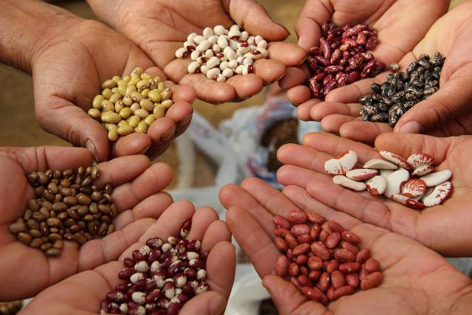
Phaseolus Vulgaris

Slide 11
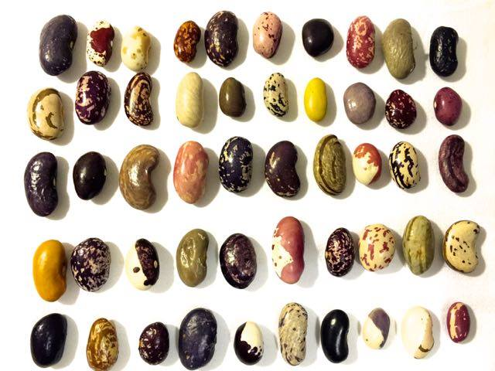
Diversity

Slide 12
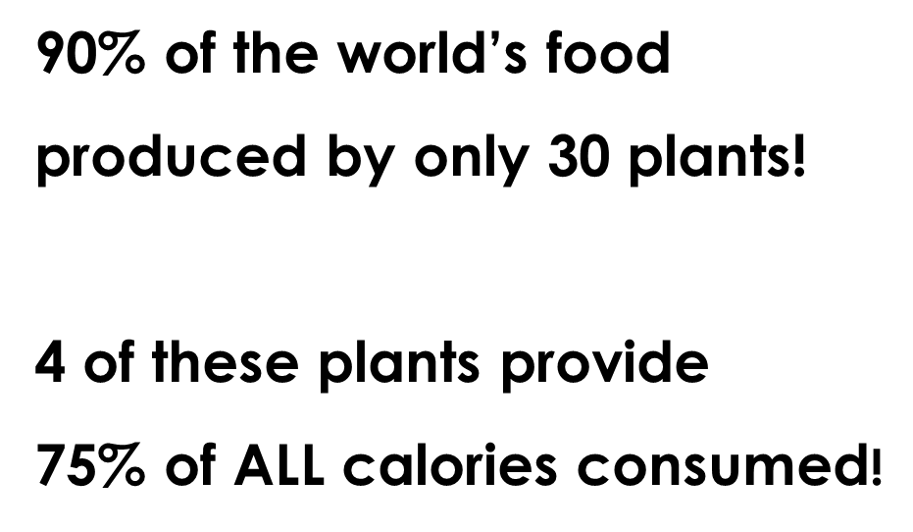
Diversity is important!

Slide 13
Corn
Soy
Wheat
Rice

Slide 14
What is Biodiversity?
Biodiversity is essential for the processes that support all life on Earth, including humans. Without a wide range of animals, plants and microorganisms, we cannot have the healthy ecosystems that we rely on to provide us with the air we breathe and the food we eat. So Seed Libraries help the environment.

Slide 15
Preserve Genetic Diversity
So many great varieties will never see the fame of commercial seed catalogs. Some varieties only exist in the hands of 1 or 2 gardeners. Lend a hand and save some of those seeds that are in danger of disappearing

Slide 16
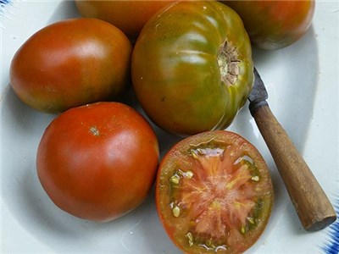
Thorburn’s Terra-Cotta Tomato

Slide 17
Many Heirloom seeds have a history or a story
King Tut Purple Pea

Slide 18
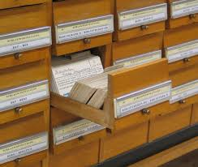
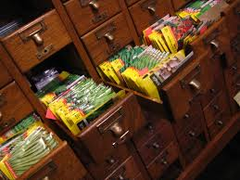
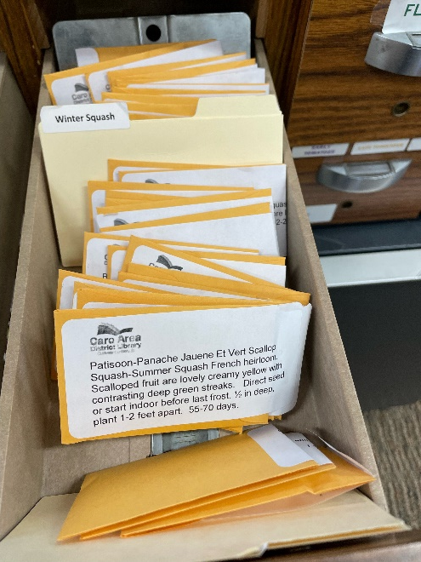
Library = Library

Slide 19
We started the Seed Library in 2012
Webinar put out by Pima County Library and Seed Savers Exchange.
Our first donation was from Pima County Library and Seed Savers Exchange
Total start up was about 30 bucks for donation, labels, and packets.
It has gotten more expensive over the years but if you start out little its very cheap.
Labels, Coin Envelopes, and seeds.

Slide 20
Planning & Assessment
Seed Libraries are not one size fits all. Each one is unique and is based on the time and resources that your library has.
Look for local initiatives that may be able to collaborate with you:
Garden clubs, community gardens, schools, MSU Ext
Can you use volunteers to help with any setup?
Start small and grow over time

Slide 21
Lending Considerations
Who can check out and how (affects how/if statistics are gathered)
We have little sheets they fill out and return to front desk
Some libraries have them check out seeds.
Limit the number of seed varieties or packets per person/family? We say 10 packs per visit
Will you require seeds only be taken if the patron can return?
We encourage best practices/request only, not require
Weather happens
Some seeds very hard to pollinate and save correctly
Lending rules vary from library to library – do what works best for you!

Slide 22
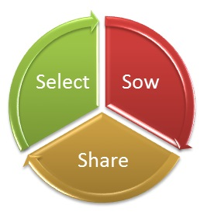
At the end of the season we suggest that our patrons try to save an easy seed like beans, peas, or lettuce if they have no seed saving experience.
We

Slide 23
Where do the seeds come from?
Join the Community Seed Network through Seed Savers Exchange
Receive a copy of “The Seed Garden”, blossom bags, seed screen, about 20 varieties of seeds.
Request donations from Heirloom seed companies –Baker Creek Seeds, SSE, Hudson Valley Seed Library
Ask your patrons! Be specific for what you want – no hybrids, please.
We created a donation form for patrons to use

Slide 24
Repackage your seeds!
Each packet of seeds that you receive can be broken down into several more.
Have a seed stuffing party!
Plan this before March
Have your materials all ready
Paper envelopes or plastic ziplock bags
Printed or handwritten labels?
Organize your seeds
Alphabetical
By family/variety
By seed saving ease

Slide 25
Just an example

Slide 26
Network Connections
So many networking connections within the community. These are just a few.
MSU Extension
Canning and freezing course
Gardening, seed saving and putting your garden to bed for winter
Small farms
Master gardeners
Greenhouses

Slide 27
Our Mission The Seed Lending Library's mission is to promote a community that values gardening and seed saving through free heirloom and open pollinated seeds, we hope to help support gardeners and seed savers from beginner to expert, through the process of growing, harvesting, seed saving, and seed sharing. About Us We started passing out seeds in 2012 and our program has grown each year. Our goal is to encourage the community to save seeds and prove that seed saving is a vital life skill. We want to bring the community together and show patrons how to grow some of their own food, reduce food cost, return flavor back into food, help the environment, create a sense of self reliance, and pass along seeds from early generations.

Slide 28
Evolution of Our Seed Library
Started in 2012
Growing ever since
Started the Home Grown Food Series: Gardening Classes, Canning Classes, Composting, Bee Keeping, Cooking, and etc
Network connections allowed for donations like Square Foot Garden
We Started a Garden in the back yard
We now have 5 square foot gardens
Friends of the Library bought us things like a small fence, dirt, a canning
Tuscola Community Foundation Grant

Slide 29
Jim Will from Will’s Greenhouse
He was one of my biggest supporter, fan and mentor. He does a program for us every year and also donates something to the library every year. This year it was a Square Foot Garden

Slide 30
Getting Ready for our donated Square Foot Garden

Slide 31
Laying down a weed barrier

Slide 32
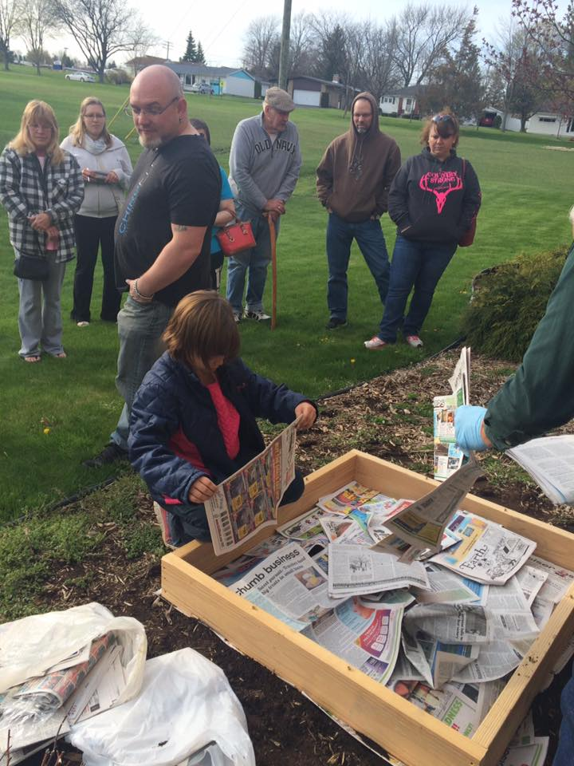
This happened during our SFG program!

Slide 34
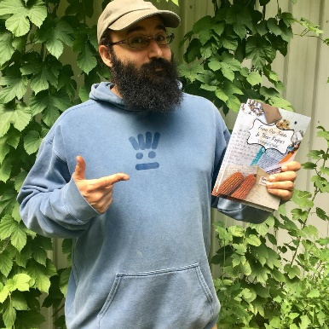
Other Considerations
Learn about seed saving and cross pollination
So much online for quick knowledge
Ben Cohen is a wonderful resource. Great speaker, presenter who has written about seed saving and many other things related to seeds. He owns Small House Farms in Sanford and has a huge seed swap coming up in next weekend
https://www.facebook.com/MISeedLibrary
One Seed, One State Initiative
135 Seed Libraries in Michigan

Slide 35
Resources For Seeds
www.communityseednetwork.org
www.highmowingseeds.com
www.seedsnow.com
www.anniesheirloomseeds.com
www.rareseeds.com
www.seedlibrary.org
www.miseedlibrary.org
www.seedsavers.org
www.smallhousefarms.com

Slide 36
Questions?
melissa@carolibrary.org
989-673-4329 ext 107

